Slide 1


CAPSTONE PROJECT
Shop For Home (ECommerce Website)
Submitted by:
Ayush Verma | ayushx16@gmail.com | Group 4 C2 batch
Mayank Parihar | pariharmayank50@gmail.com
Indrajeet Kumar Mahato | 10indrajeet02@gmail.com
Aman Grover | gaaman56@gmail.com
T Narasimhulu | narasimhuluptn@gmail.com
Under the Guidance of
Ashutosh Trivedi
(Training mentor Great Learning)

Slide 2
ABSTRACT
ShopForHomeis a popular Store in the market for shopping the home décor stuff .Due to Covid 19 all the offline shopping stopped. So, the store wants to move to the online platforms and wants the own web application.
•Consumers find a product of interest by visiting the website of the retailer directly or by searching among alternative vendors using a shopping search engine, which displays the same products availability and pricing at different e-retailers.
•Users can login to the website to shop the products for home decoration and It has the features of add to cart ,Wishlist and make orders from home
•When an online store is set up to enable businesses to buy from another businesses, the process is called business-to-business (B2B) online shopping.

Slide 3
INTRODUCTION
This project Shop for Home has been developed in Angular, Java Spring Boot and PostgreSQL. The Shop for Home project is an application which is based on managing the Home-decor and sell the household items online. The main purpose for developing this project in Angular and Java Spring Boot is to manage all the details about home decor item, home decor category, company, order, sales etc. There are two categories of user available in this project. First one is admin and second one is user. Admin can add home-décor item category and can also manage the sales details. This Angular project very helpful for maintaining the sales activity in household item. In this project customer can see the details of home-decor item category etc. Only Admin can edit or delete the details of Home-decor item.

Slide 4
PROJECT OVERVIEW
Shop From Home
User Login
Resister
API
Authentication
Login Successfully
Credential's mismatch
Wishlist
Search
Checkout
Cart
DB
External Api

Slide 5
Admin Login Flow Chart
Admin Login
Home
Admin
Login
Admin
Operation
Track
Manage product
Increase decrease Stock
Email
Discount
User
Option
Coupon
Activity
Data

Slide 6
User Login
Flow Chart
User Login
Home
Login
Register
Dashboard
Cart Option
WishList
S
e
a
r
ch
the
Increase/decr
Check
Add
Product
ease
out
product
Details
product
Quantity
into
WishList

Slide 7
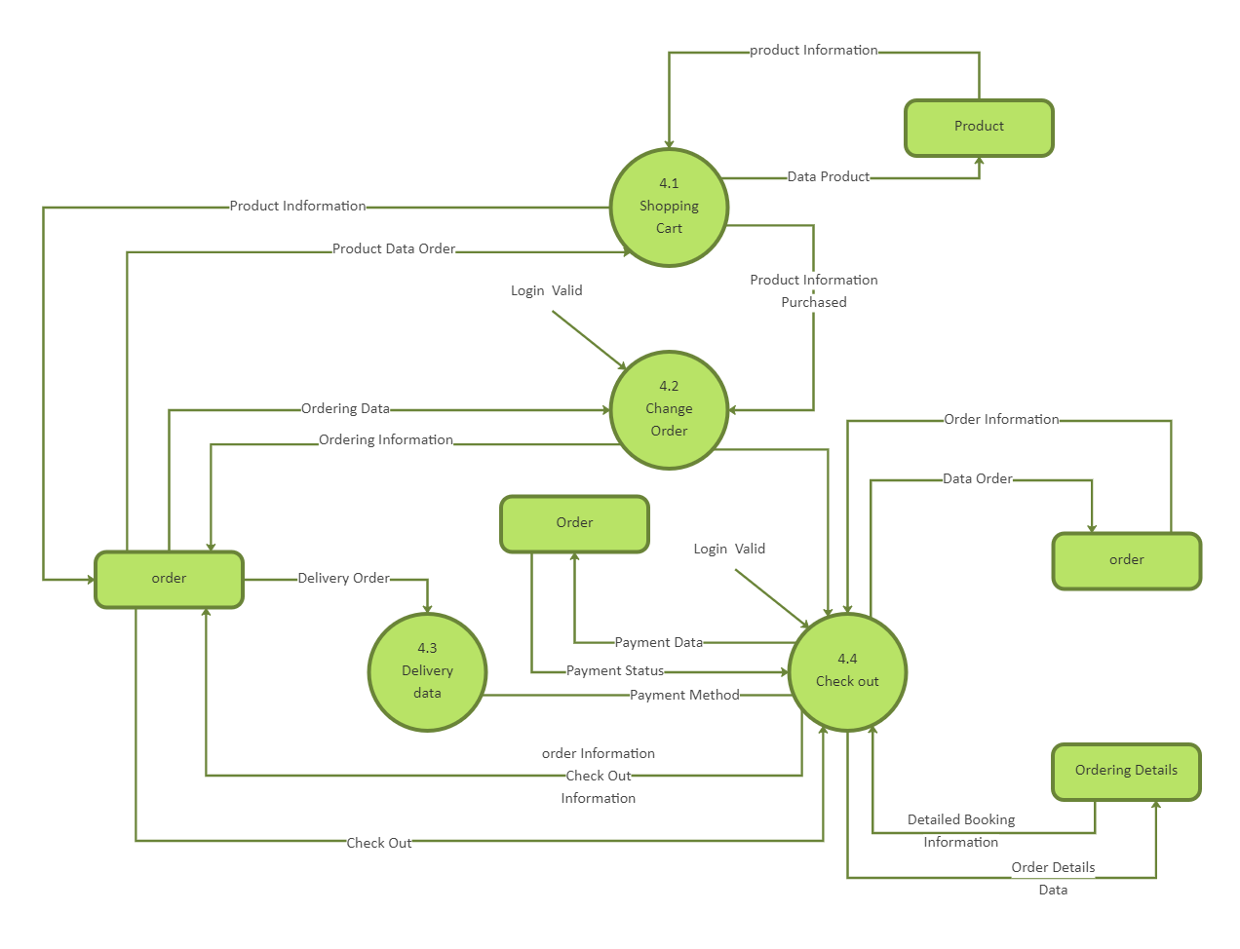
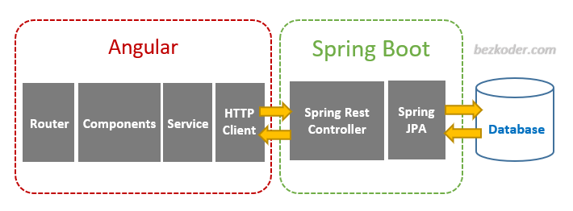
DFD AND PROTOTYPE VIEW OF THIS APPLICATION

Slide 8
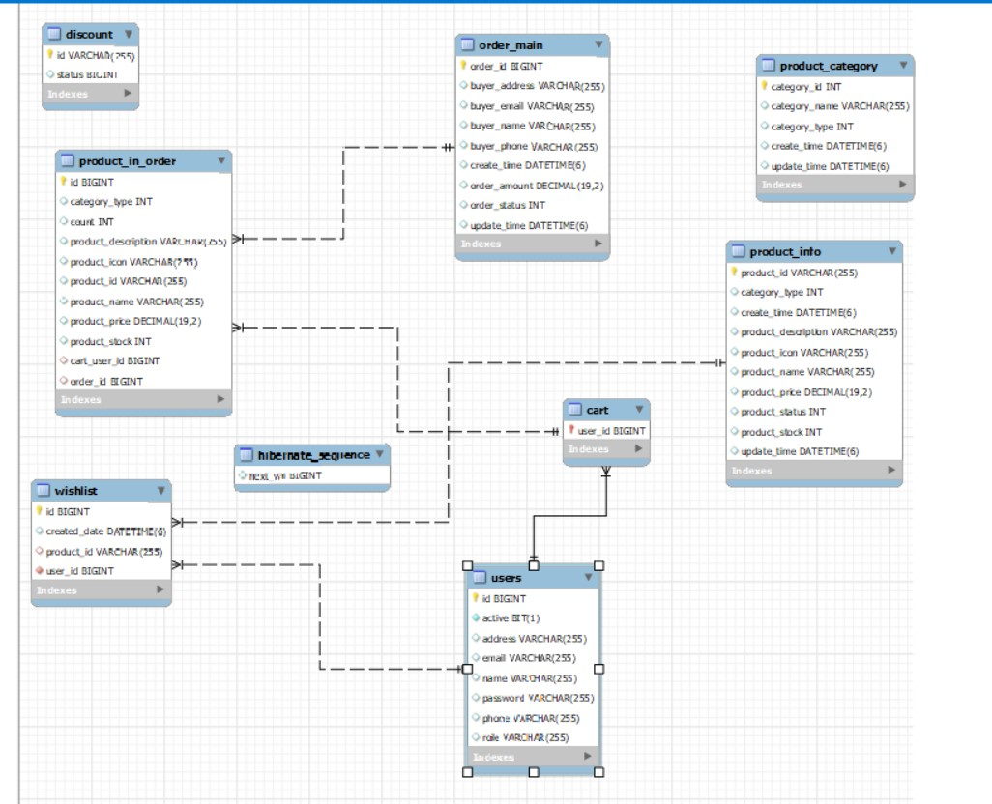
Databse

Slide 9
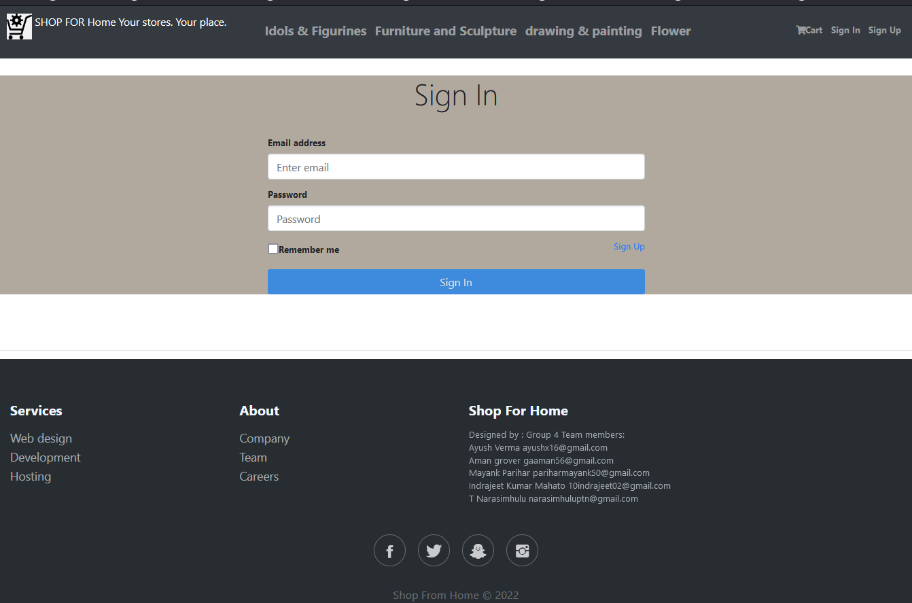
Sign In Page

Slide 10
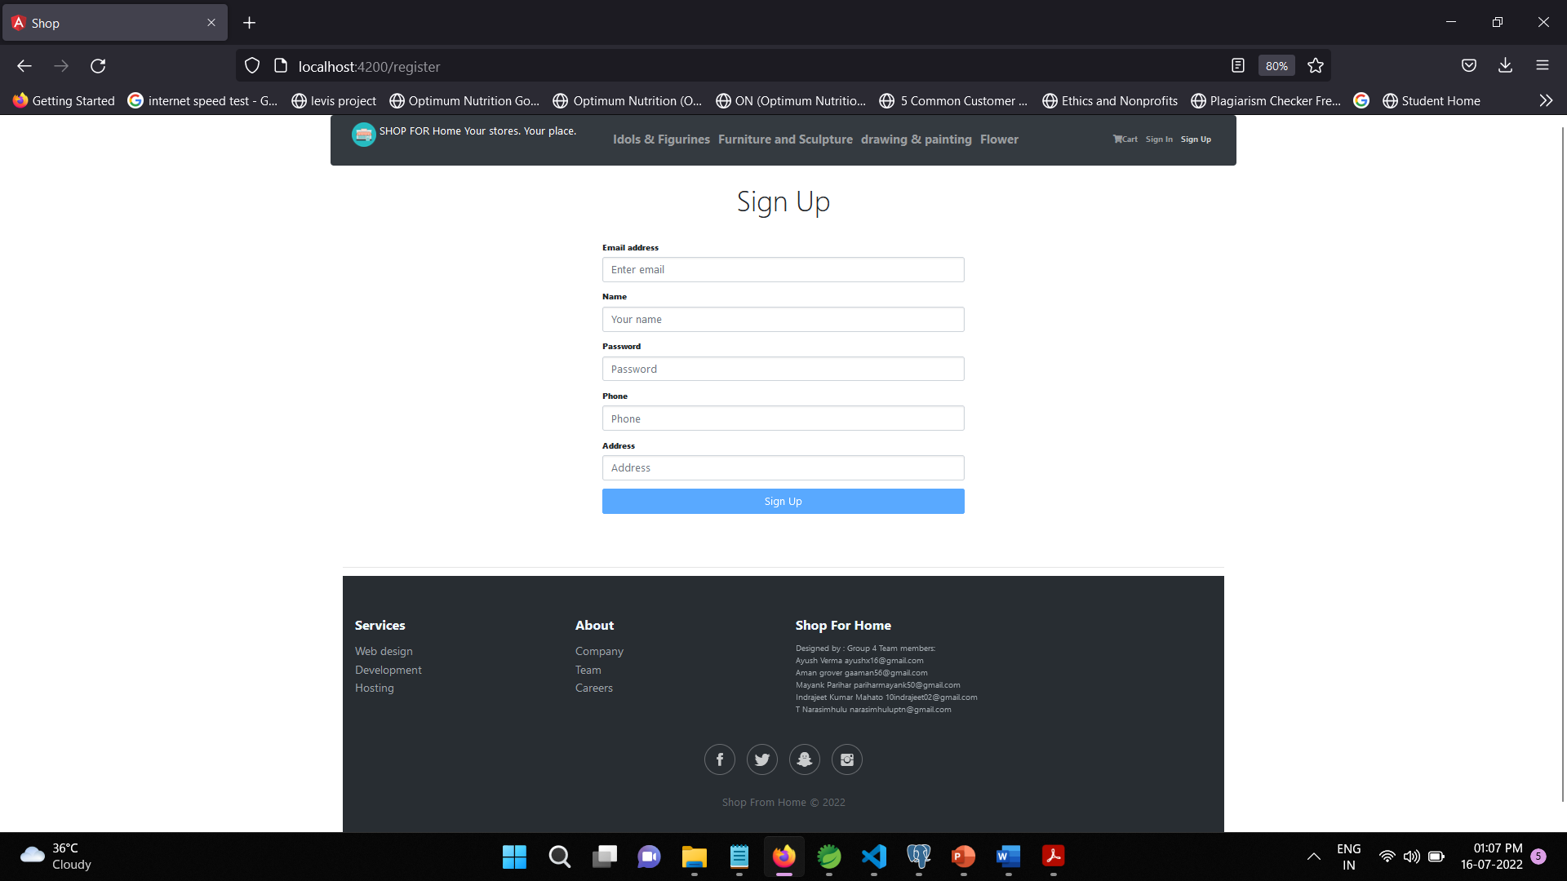
Sign Up Page

Slide 11
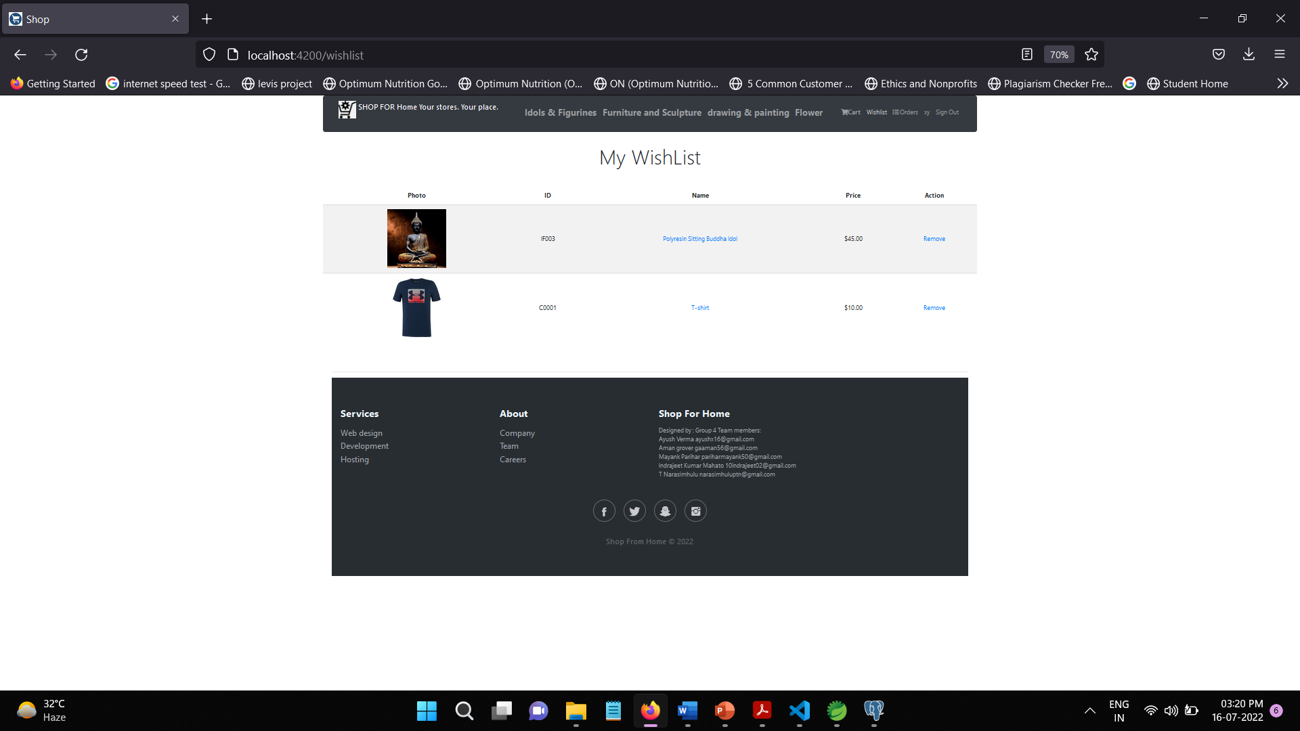
Wish List Page

Slide 12
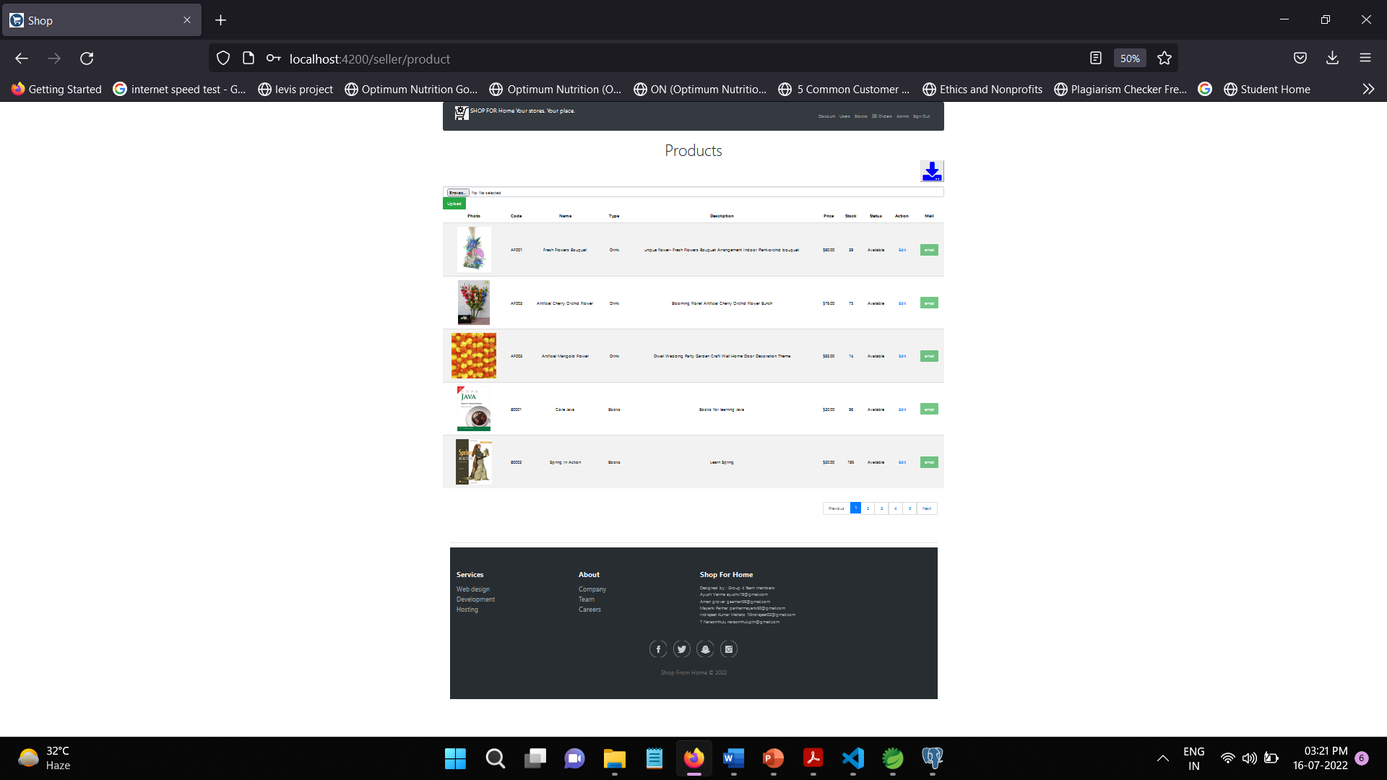
Products Page

Slide 13
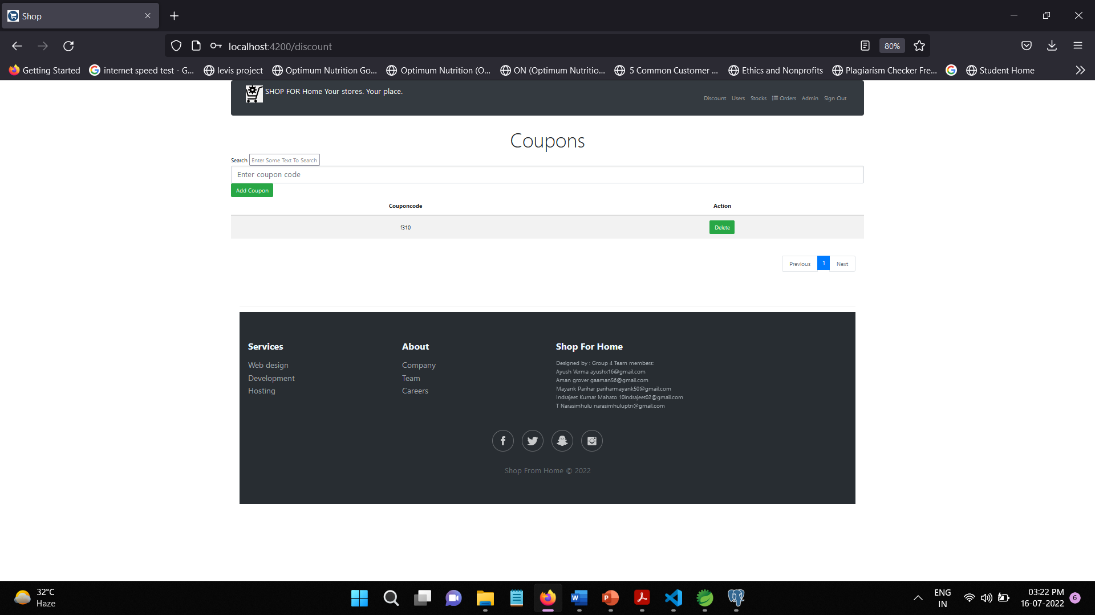
Discount Coupons

Slide 14
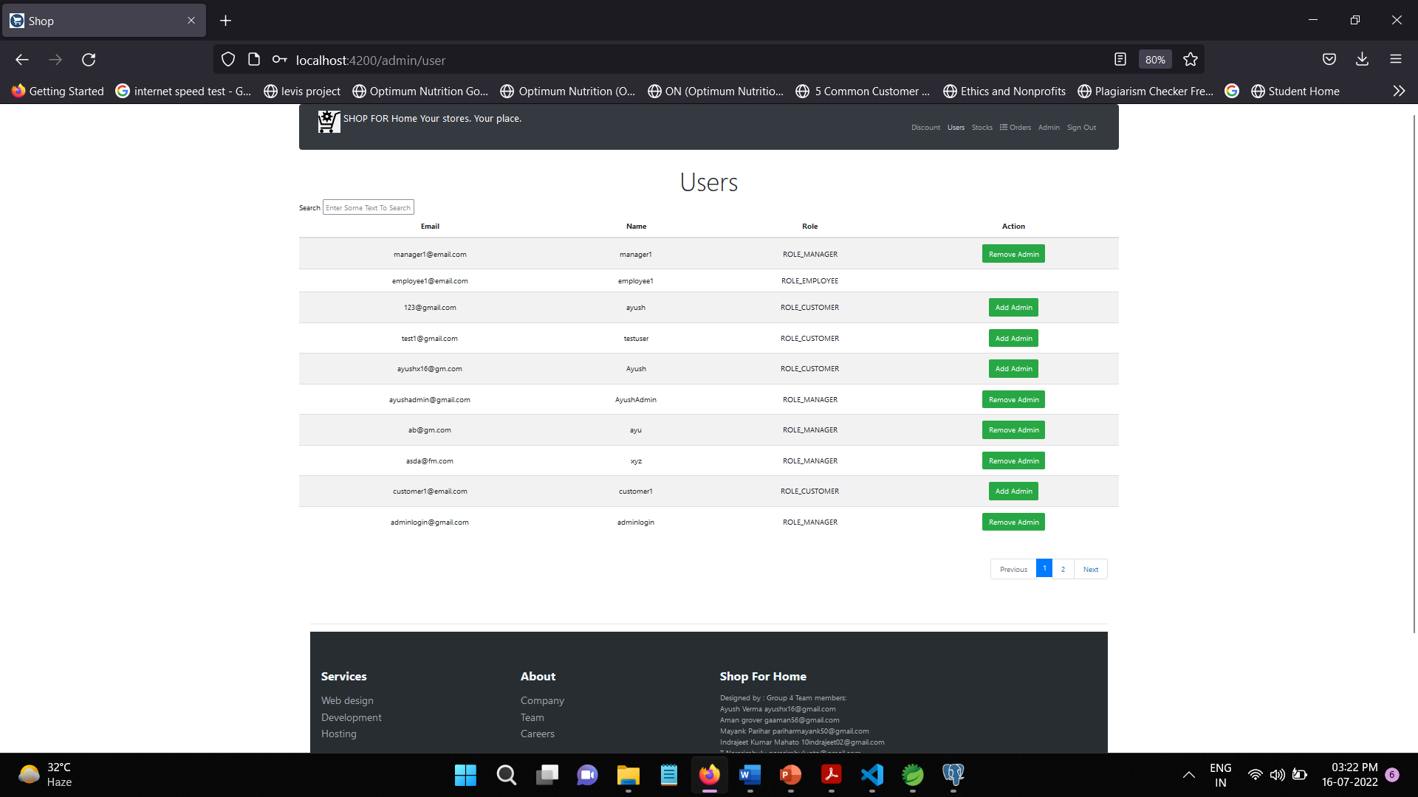
Admin Control For Users

Slide 15
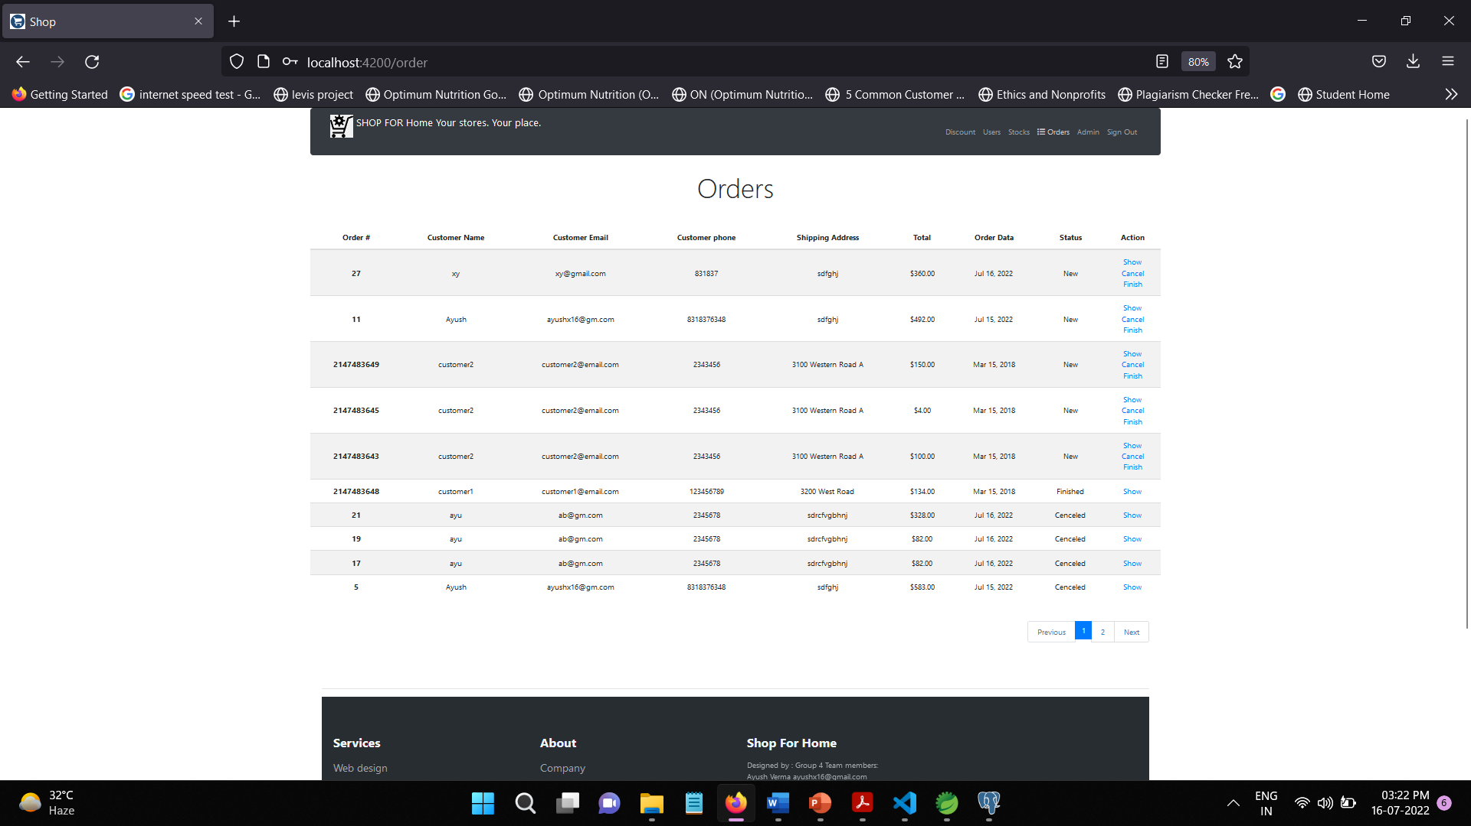
Orders placed by users

Slide 16
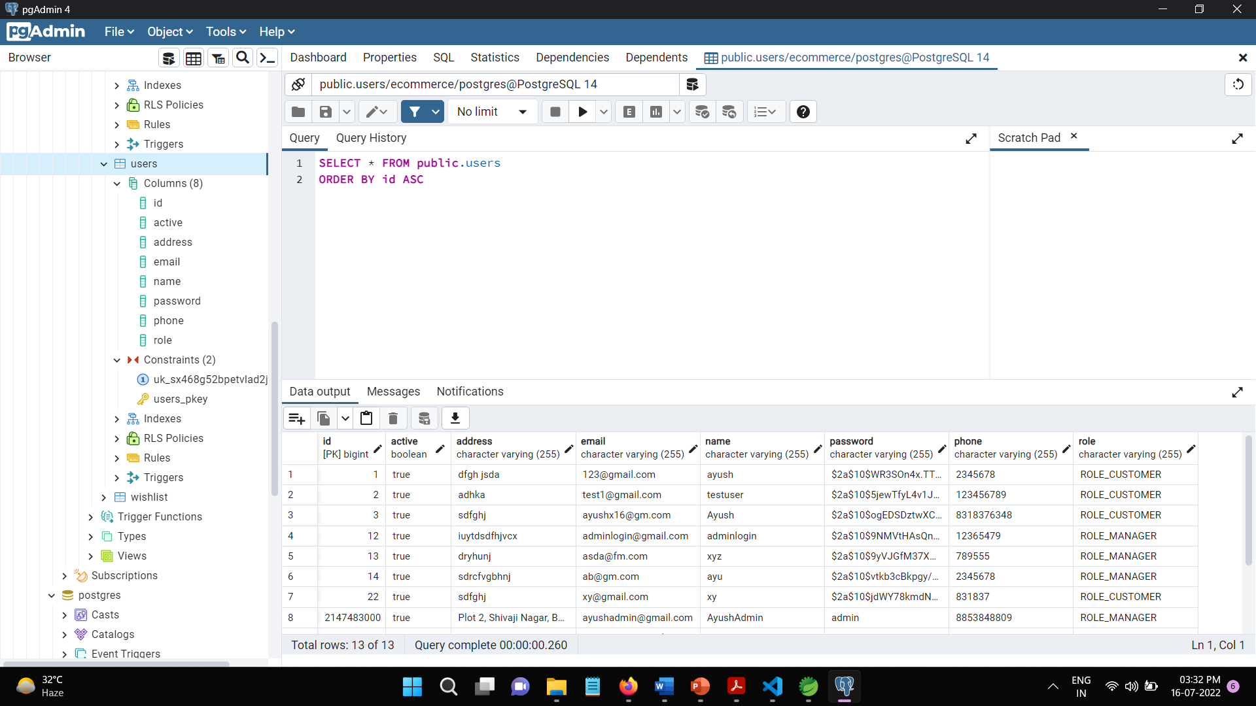
Users Database

Slide 17





TECHNOLOGY USED

Slide 18
Thank you

